Slide 1

Teaching the IT Pro how to Dev
The Intro Session
Points to Consider
This is an intro session
Not a deep dive into the associated technologies
But should leave you understanding why you should spend a little more time with them all
Ryan Yates - @ryanyates1990
User Group co-ordinator for PowerShell User Groups in UK

Slide 2

Who Am I?
Ryan Yates – 26 & a Microsoft Cloud & DataCentre Management MVP predominantly focused on Windows 10, PowerShell, Azure & historically SharePoint
Coordinator of Get-PSUGUK – The UK PowerShell User Groups http://www.get-psuguk.org
Co-Organiser of PSConfEU – the Premier PowerShell Conference of the year – http://www.psconf.eu
Technical Director at Re-Digitise – https://www.re-digitise.org
Frequent speaker at SharePoint, SQL, PowerShell and other Technology events Worldwide.
@ryanyates1990

Slide 3
Get-PSUGUK ??
A User Group Dedicated to Windows PowerShell – Language and Implementation practices
Currently in London & Manchester
Will be expanding to other Cities in the UK over 2016 – Exeter, Derby/Nottingham & Glasgow/Edinburgh are currently being discussed
Meetups are currently being planned for London this month.
Further details & Slack Signup at www.get-psuguk.org
@ryanyates1990

Slide 4
History Lesson
As a SharePoint Guy in a previous role – I’ve seen cases of document management hell – and really a script is just another document
Unit Testing our scripts is something that we all know that we should be doing – but I bet that most aren’t.
You may have some sort of method for dealing with Script Versioning – but is it optimal? Does it work well with OSS PowerShell Projects?
Version Control is an Alien Topic to most IT Pro’s and a number of Developers as well
So how can me make the transitions to optimal Source Control & carrying out Unit Tests easier?
@ryanyates1990

Slide 5
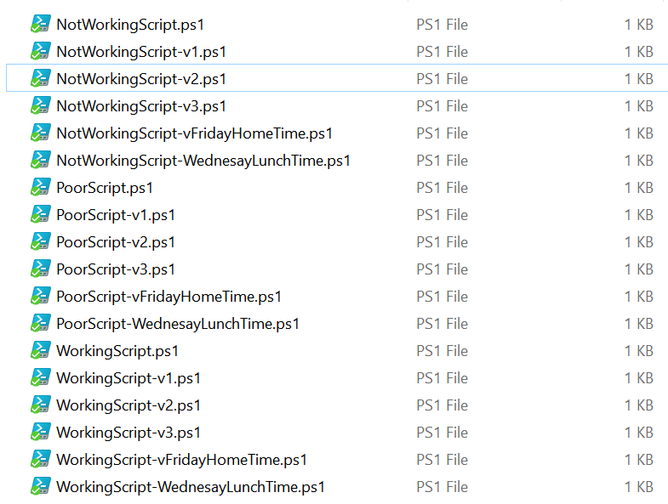
Does this look familiar?
@ryanyates1990

Slide 6
Making ISE easier for use
Extending PowerShell ISE with a PowerShell Module called ISE_Cew – Available on GitHub or PowerShell Gallery
This gives us
Easy Version Control on File Saves in ISE
Script / Module Distinction – Building out required directory
Consistency & Peace of Mind
Requirements
PowerShell v4 or above (for now)
PowerShell ScriptAnalyzer
Pester
Git
2 PSDrives Scripts-WIP & Modules-WIP
@ryanyates1990

Slide 7
Using VSCode
Pros
Git support Built in – So you have Version control
In latest Builds has an integrated Script Panel – configurable to PowerShell
ScriptAnalyzer support now built into
Multi Use editor – PowerShell / C# / JS etc
Cross Platform
Underlying platform is being actively developed by PowerShell Team
Cons
Requires PowerShell Extension
Still requires lots of work to be the go-to PowerShell Editor
Additional install that you may not be able to run i.e on a server
Under continuous development – features may change on future builds
@ryanyates1990

Slide 8
Using Visual Studio
Pros
Git support Built in – So you have Version control (at least in Community 2015)
PowerShell Tools addon by Adam Discoll gives Intellisense & PowerShell Project Definitions
Multi Use editor – PowerShell / C# / JS etc
Cons
Still requires lots of work to be the go-to PowerShell Editor
Additional install that you may not be able to run
Too clunky for most PowerShell tasks
PowerShell Tools bug caused multiple modules to have same GUID in PowerShell Gallery – (Now fixed)
@ryanyates1990

Slide 9
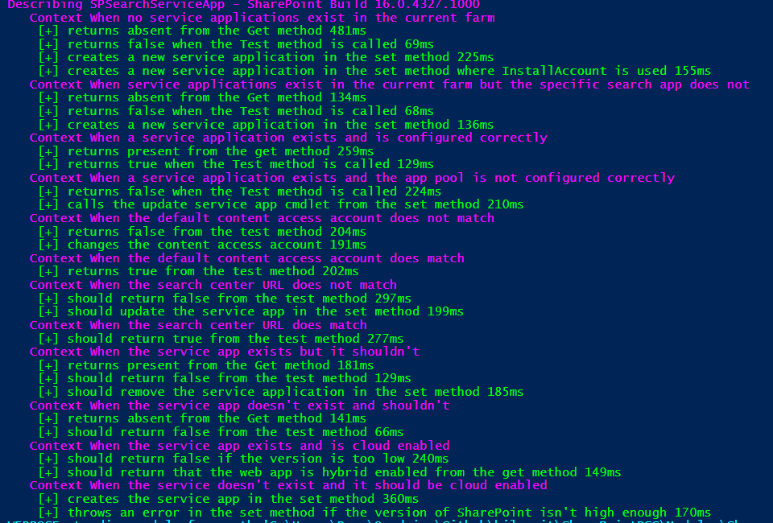
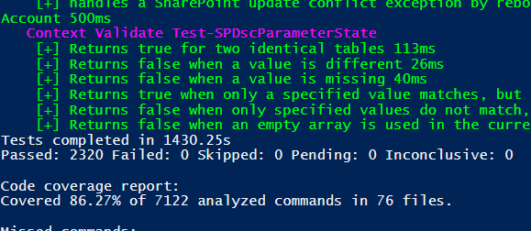
Pester
A Unit & Integration testing Foundation Framework
Written in PowerShell
Tests Written in Human readable syntax
Prerequisite to have Pester Tests for DSC Resources – like SharePointDSC to test that code does what we expect it to
Based on RSpec – the Ruby Testing Framework
Additional layers of Frameworks being added – OVF, PoshSpec – to name a few
A Key component for TDD
Makes you not destroy existing scripts as you look to refactor (when tests are written well)
@ryanyates1990

Slide 10
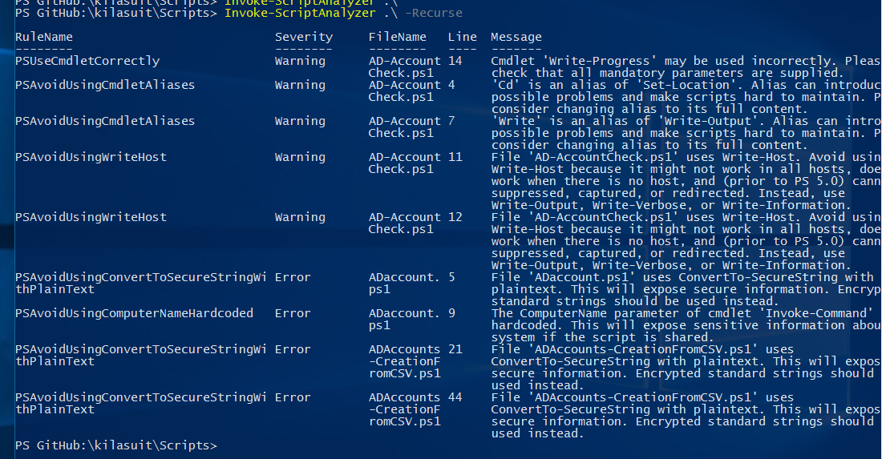
PSScriptAnalyzer
Static Code Analysis of your PowerShell scripts – think SPCAF
Written in C# but can be extended with PowerShell or C# Rules
Continually being worked on
Submits to the PowerShell Gallery get Run through the Script Analyzer and fails can mean that a submission gets removed
Helps you to write better PowerShell
Based on StyleCop and other Code Analysis frameworks
@ryanyates1990

Slide 11
So ……?
Let’s Get into a demo of this now

Slide 12
Any Questions??

Slide 13
Further references
PSConfEU - June Blender MVP – Test Driven Development with Pester - https://www.youtube.com/watch?v=gssAtCeMOoo
PowerShell Summit – Steven Murawski MVP - Testing DSC Resources with Test Kitchen & Pester - https://www.youtube.com/watch?v=h2P5Az3vfxk
PowerShell Summit – Dave Wyatt MVP – Automated Testing in Powershell - https://www.youtube.com/watch?v=SftZCXG0KPA
PowerShell Magazine Articles on Pester - http://www.powershellmagazine.com/?s=Pester&x=0&y=0
Irwin Strachan Blog on OVF with Pester - https://pshirwin.wordpress.com/
Pester Source Code – https://github.com/pspester/pspester
Script Analyzer Source Code – https://github.com/powershell/PSScriptAnalyzer
ISE_Cew Source Code – https://github.com/kilasuit/ise_cew

Slide 14
Further Details
Twitter - @ryanyates1990
LinkedIn - http://uk.linkedin.com/in/ryanyates90
Blog – blog.kilasuit.org
Email/Lync – ryan.yates@kilasuit.org
PowerShell User Group Meetup – Signup is at www.get-psuguk.org
SQL Saturday Manchester – Full PowerShell Track – www.sqlsaturday.com/543
PowerShell Conference EU – 3 day conference in Hannover, Germany – http://psconf.eu

